Slide 1
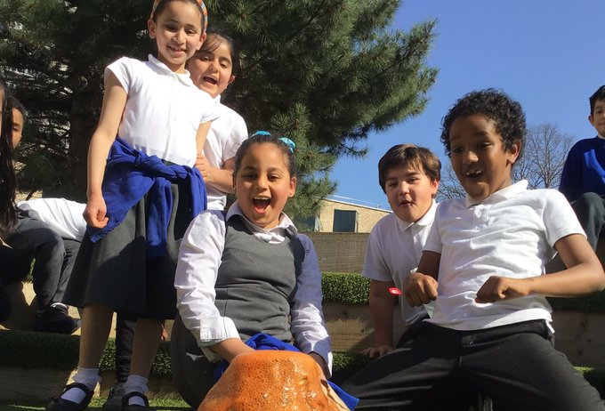

Introducing RULER

Slide 2
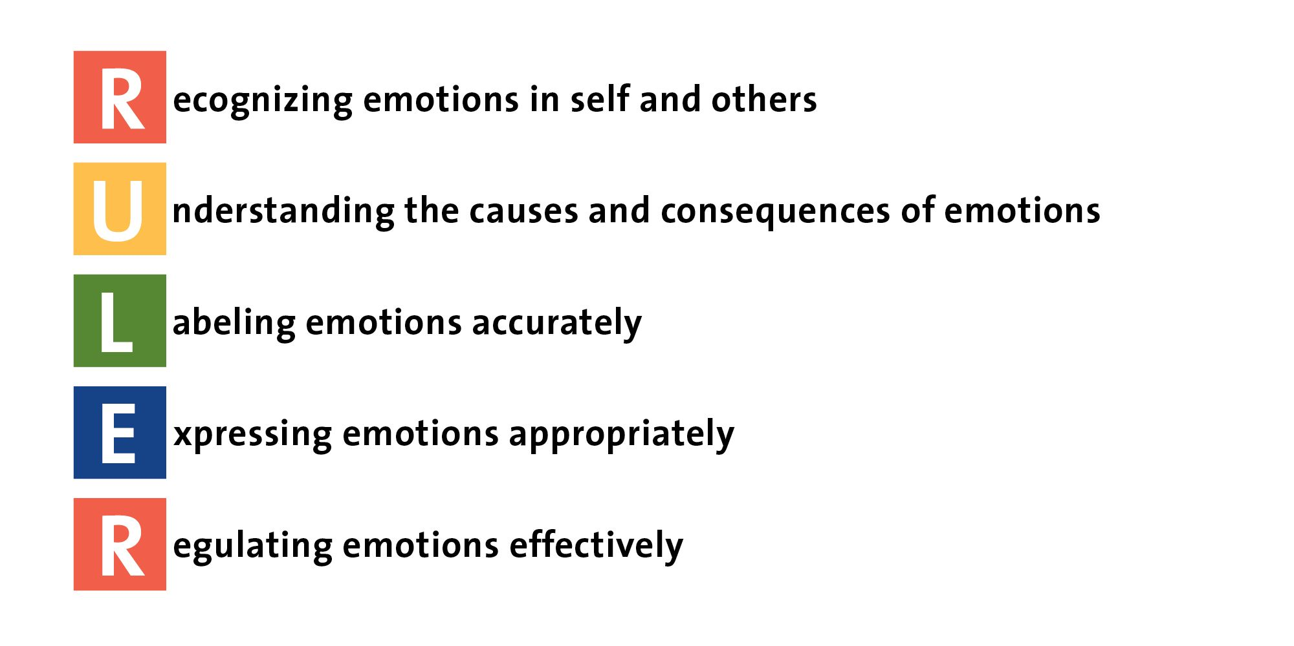

Slide 3
https://www.youtube.com/watch?v=YUkAF8oPYtw

Slide 4
Anchor TOOLS

Slide 5
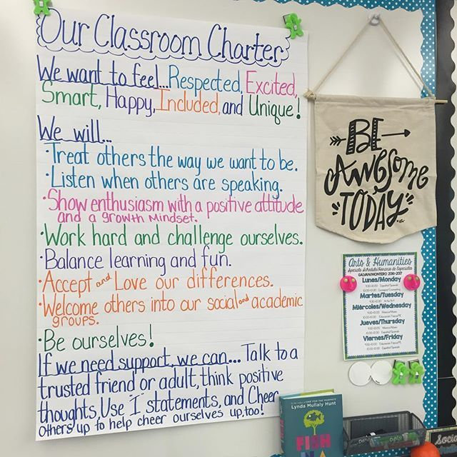
Class Charter
Using the Class Charter
https://www.facebook.com/rulerapproach/videos/using-the-charter-with-upper-elementary-students/423683471020947/?extid=SEO----

Slide 6
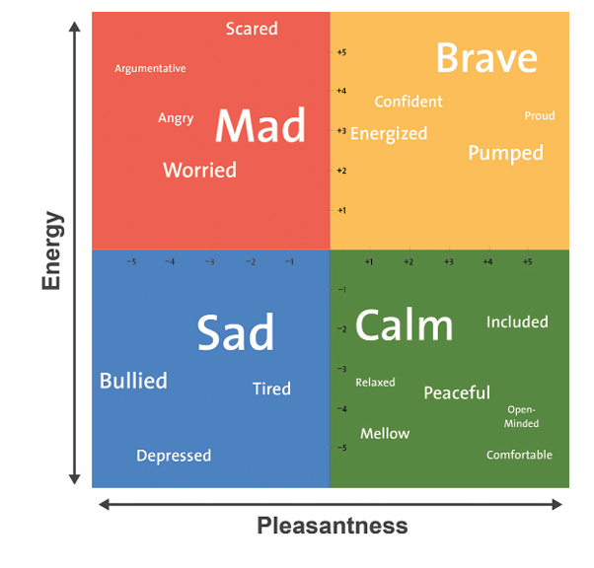
MOOD mETER
The Mood Meter An Introduction
https://vimeo.com/52622350
Pre-school RULER : The Mood Meter in Early Childhood Classrooms
https://www.youtube.com/watch?v=mkZd2VKpFrU

Slide 7
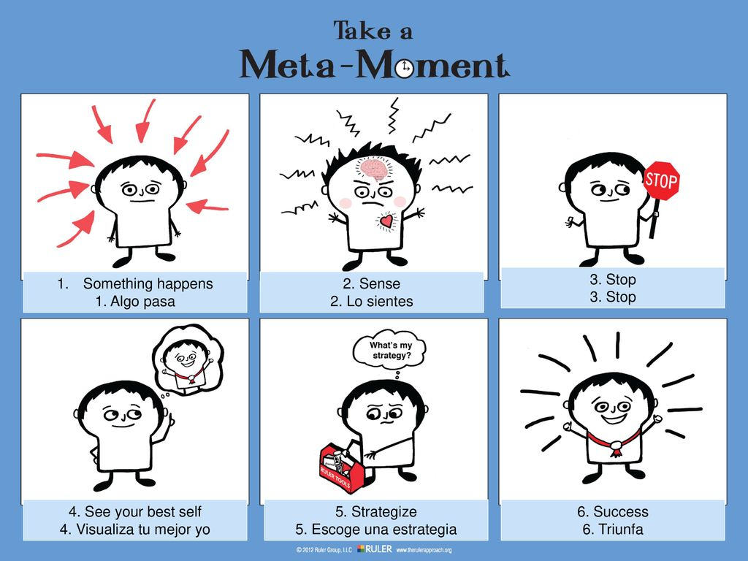
Meta moment
How to use a meta moment
https://www.youtube.com/watch?v=RfX1NefGeRQ
Meta Moment excerpt
https://www.youtube.com/watch?v=0Dr7GsTpq10&list=PLzHfSsBPUjvXR9x3UKPs1J8A8UNuORVr8&index=14
https://www.youtube.com/watch?v=RoyKL0gdUF4

Slide 8
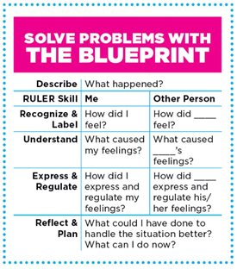
The blueprint
Blueprinting a conflict between 2 adults
https://vimeo.com/170646146

Slide 9
Using the ruler approach
Helping Toddlers Regulate Emotions
https://www.youtube.com/watch?v=-H14NNUYwVc
Growing Emotional Awareness
Emotions Matter : Growing Emotional Awareness with RULER | Zoe Hilson & Caydn Thompson | TEDxBendigo – YouTube

Slide 10
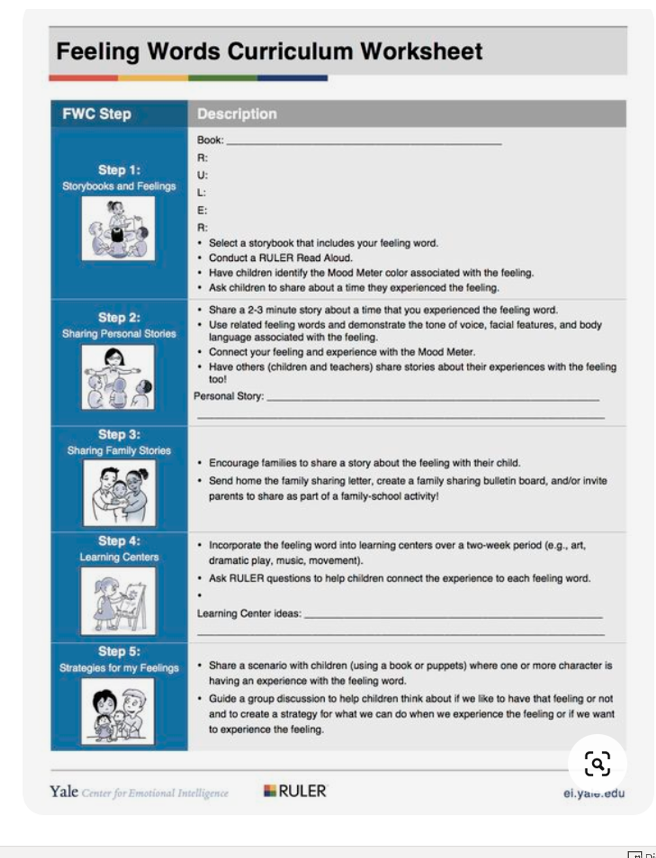
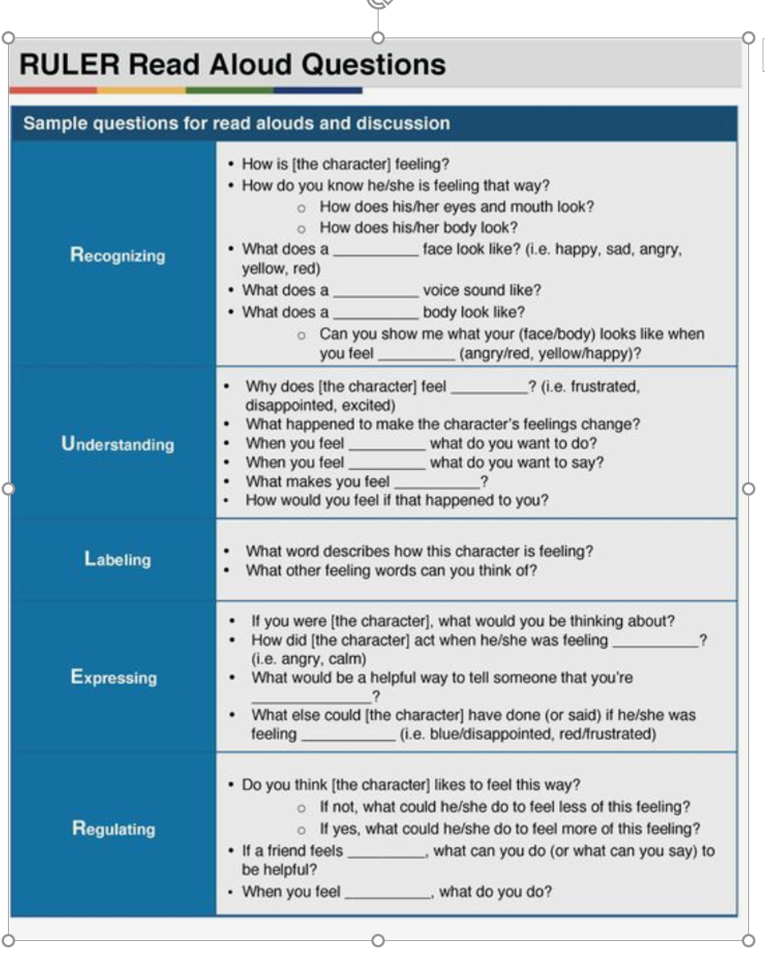
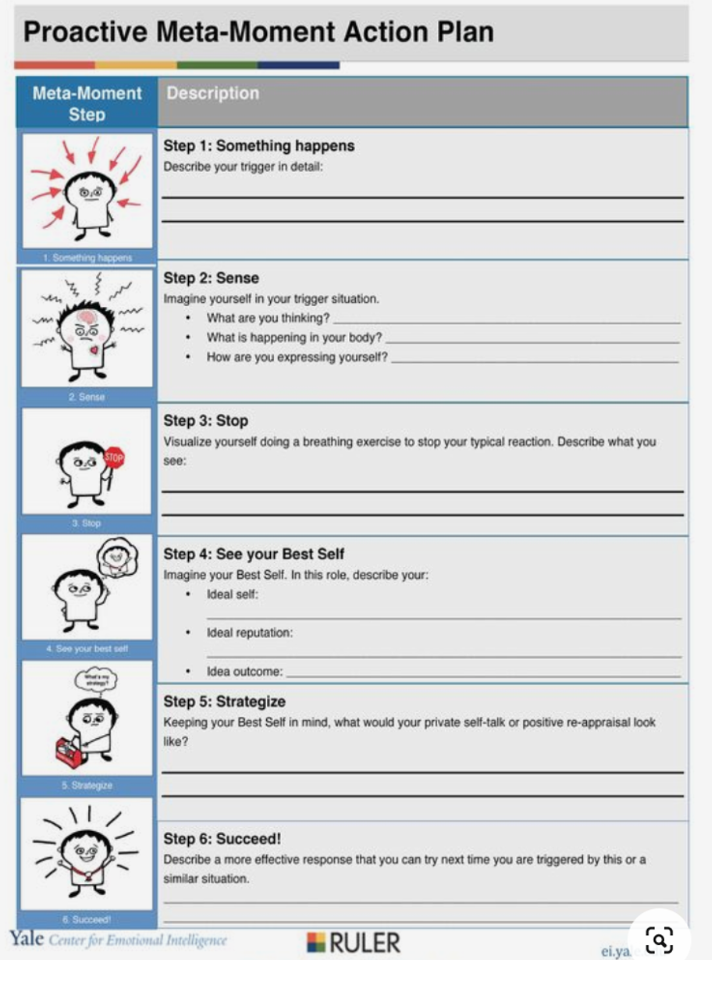

Slide 11
Mental Health progression map

Slide 12
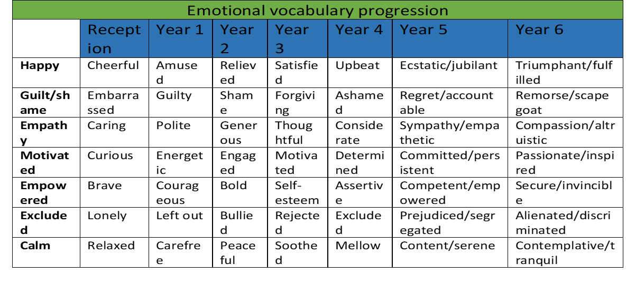
Emotional vocabulary

