Slide 1
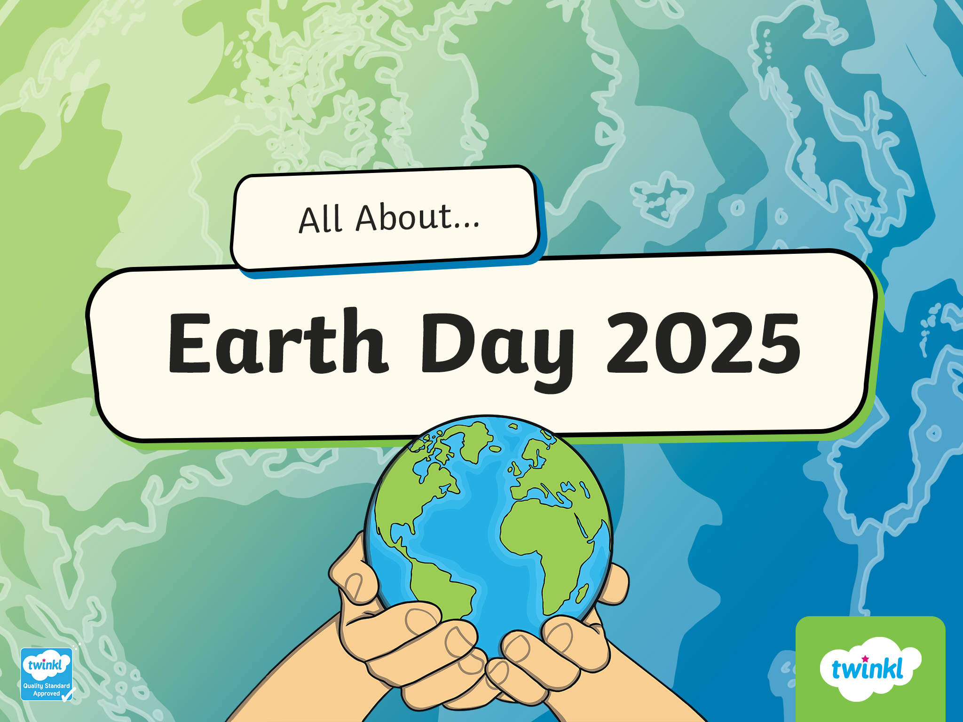

Slide 2


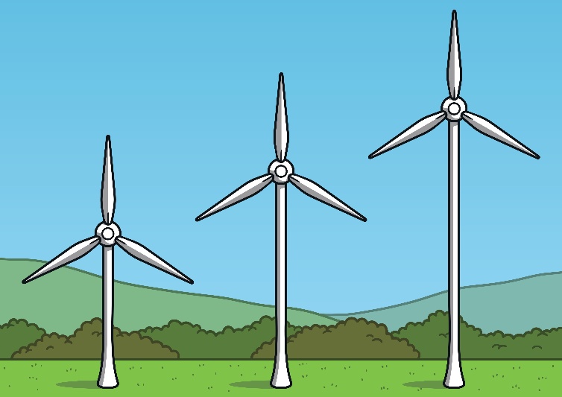
When Is Earth Day?
Earth Day takes place every year on April 22 to show support for the protection of the environment and our planet.
Since 1970, Earth Day has brought together people, governments and companies from around the world, supporting them to do something positive for the environment.
April
It promotes the fact that ‘change starts with action’ and we can all take action and encourage others to take action that positively impacts on the world around us.
This year’s theme is “Our Power our Planet”

Slide 3
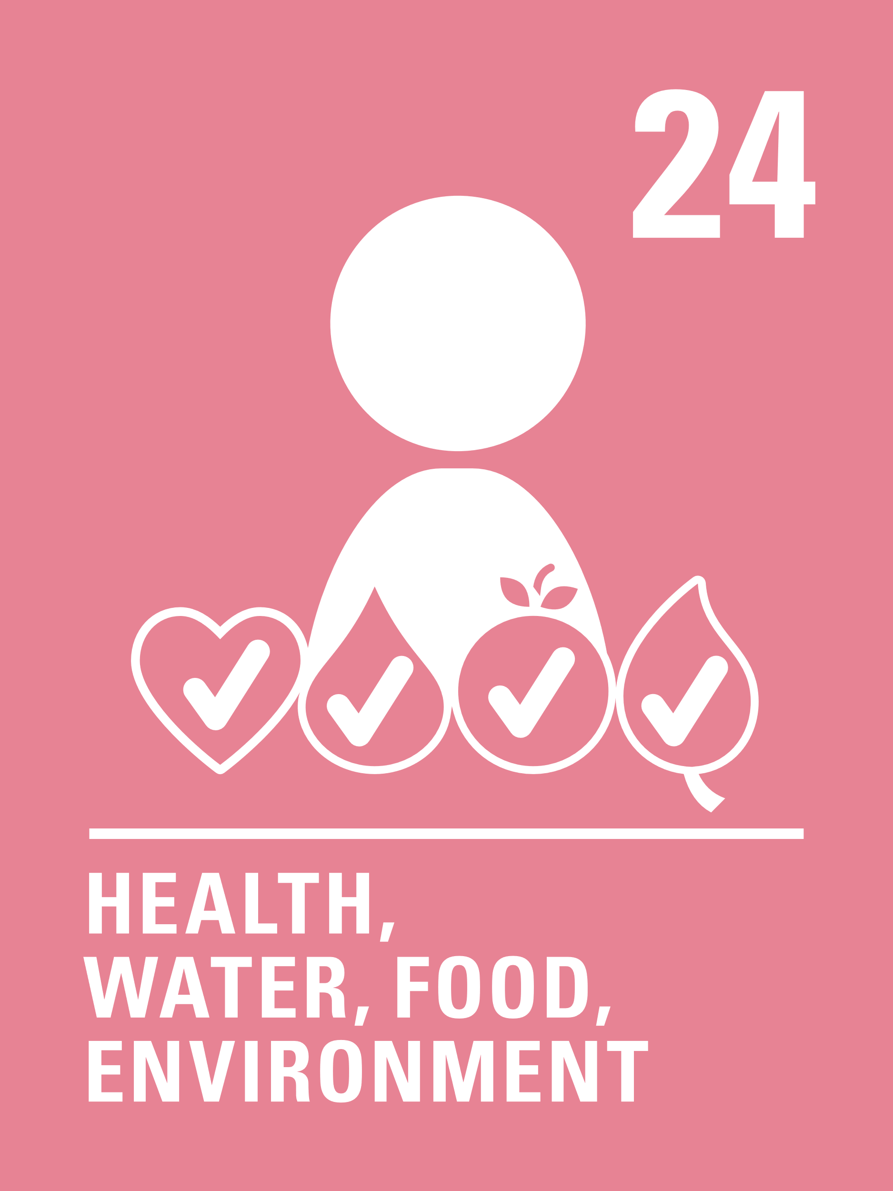


Convention on the rights of the child
The UN convention on rights of the child says that every child should have the right to:
Article 24 (health, water, food and environment)
Article 6 (life survival and development)
Every child has the right to life. Governments must do all they can to ensure that children survive and develop to their full potential.
Every child has the right to the best possible health. Governments must provide good quality health care, clean water, nutritious food, and a clean environment and education on health and well-being so that children can stay healthy. Richer countries must help poorer countries achieve this.

Slide 4
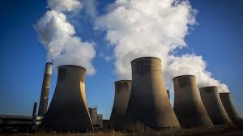
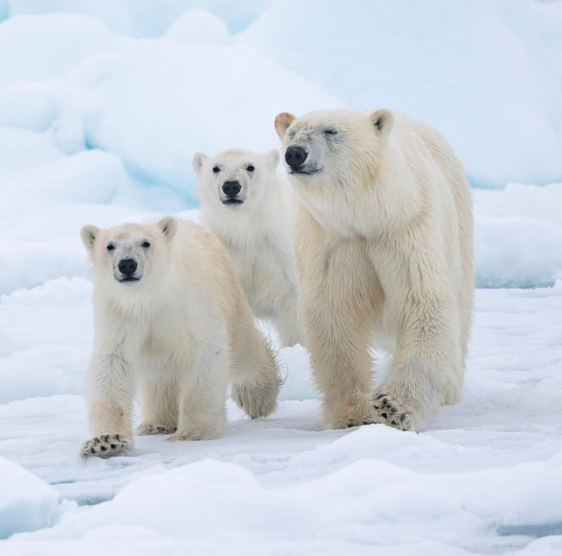
Our Power, Our Planet
This year’s Earth day theme is Our power Our planet.
Burning lots of fossil fuels to create energy causes lots of air pollution and harms our planet
We need to protect all living things and try to make sure our planet will be a safe place for everyone in the future.

Slide 5
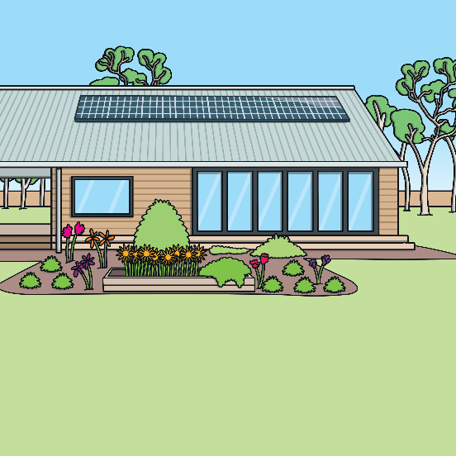


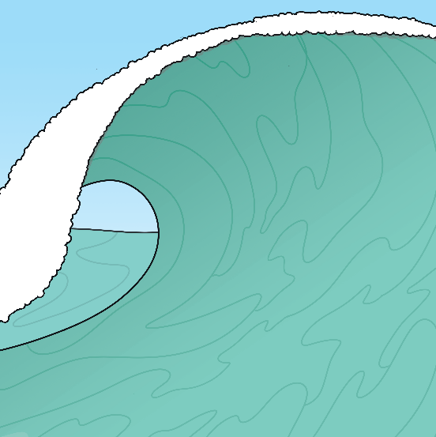
Our Power, Our Planet
There are many ways to create power while being kind and caring to our planet!
solar energy
wind energy
hydropower

Slide 6
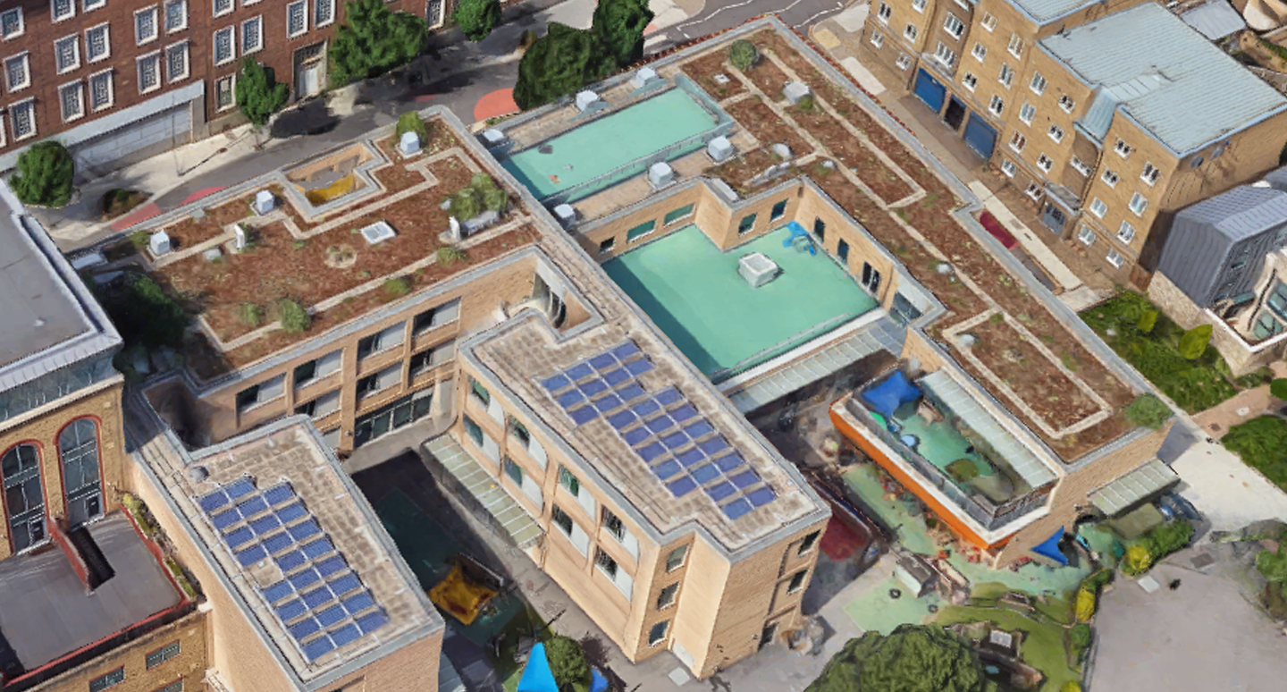


Our Power, Our Planet
Our school has solar panels on the roof to help with renewable energy.

Slide 7
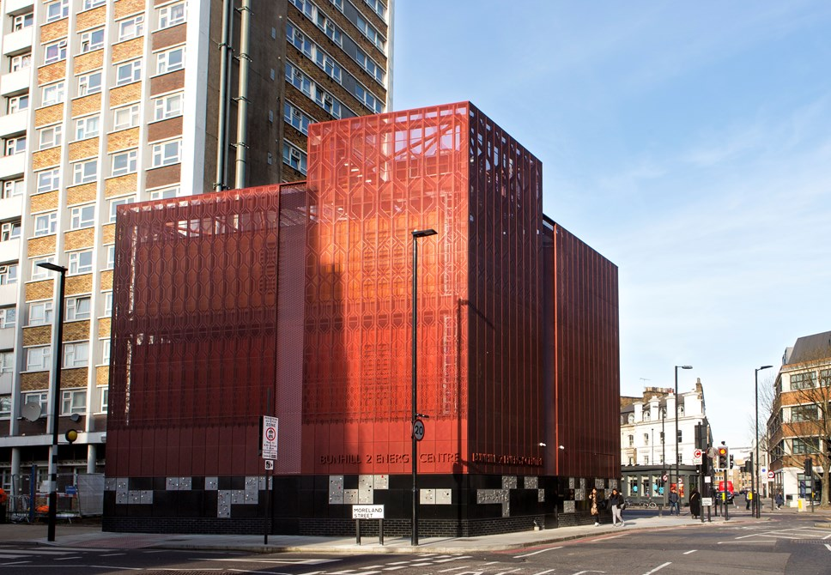
Our Power, Our Planet
We also get renewable energy from the tube at Bunhill 2 Energy centre

Slide 8

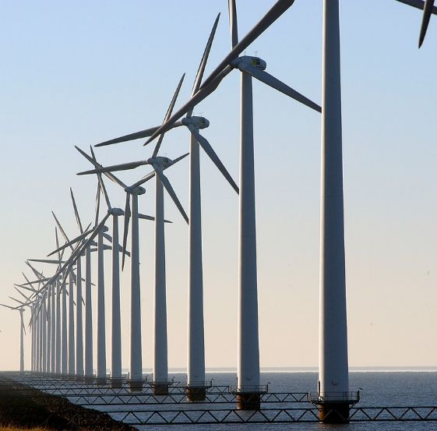
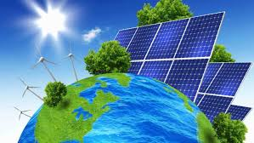
Our Power, Our Planet
We can work together to try and use less energy and use renewable energy (like solar and wind power) to create energy. That way, we can help protect our planet.
Why do
you think it is important to work together?
Renewable energy from wind farms
Solar energy

Slide 9
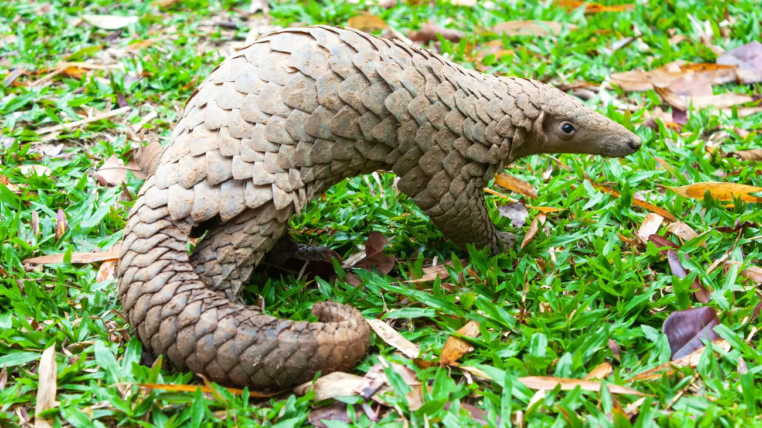
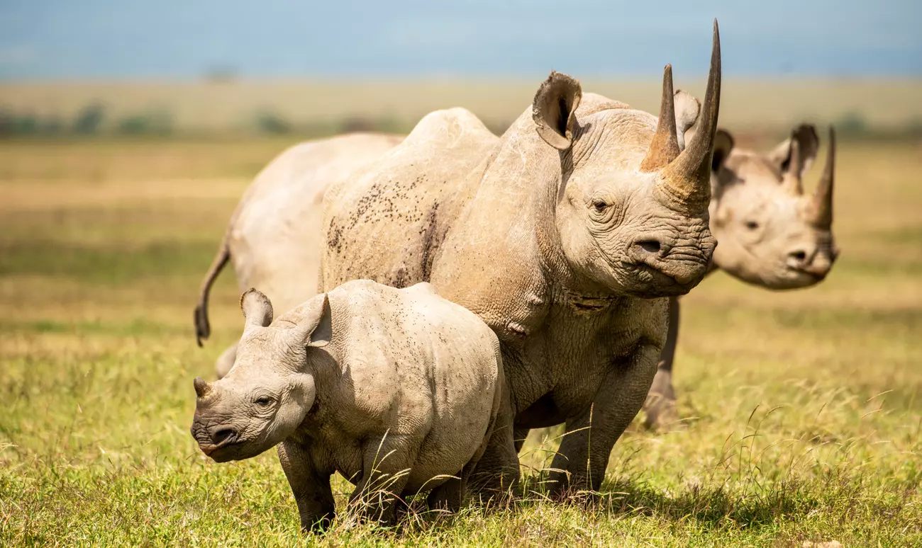

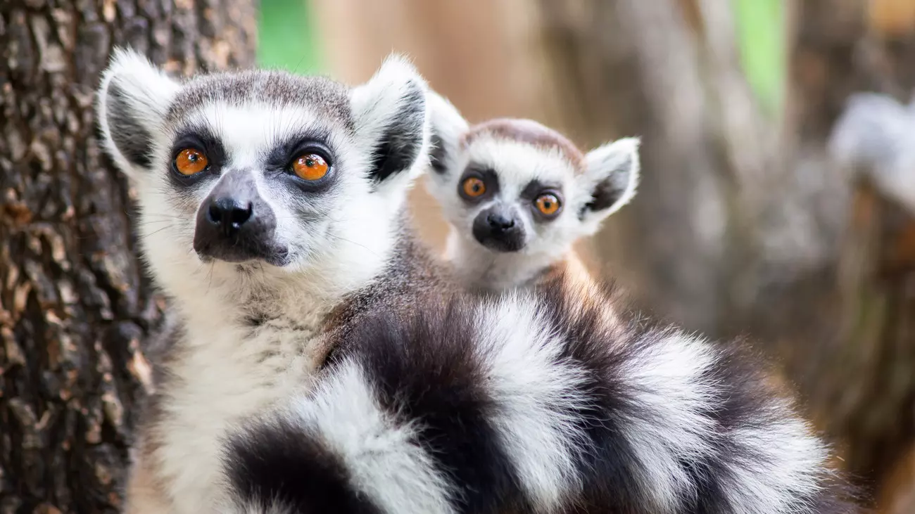
Did you know…..?
Human activities have increased the amount of a gas called carbon dioxide in the Earth’s atmosphere. This harmful gas traps heat and over time has warmed the temperature of the Earth. This can be dangerous for living things.
Many types of plants and animals are now becoming extinct faster than ever before. This means in our lifetime we may see these animals become extinct.
Pangolins
Black rhino
Human activities has increased the amount of a gas called carbon dioxide in the Earth’s atmosphere. This harmful gas traps heat and over time has warmed the temperature of the Earth. This can be dangerous for living things.
Lemurs

Slide 10
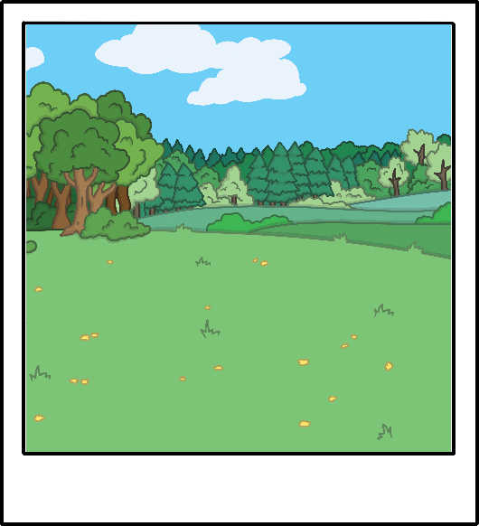
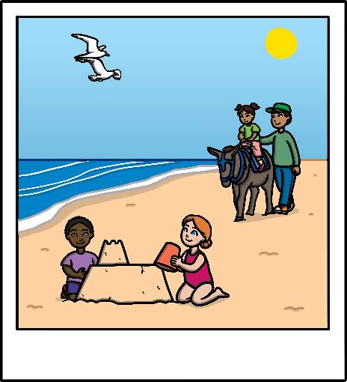
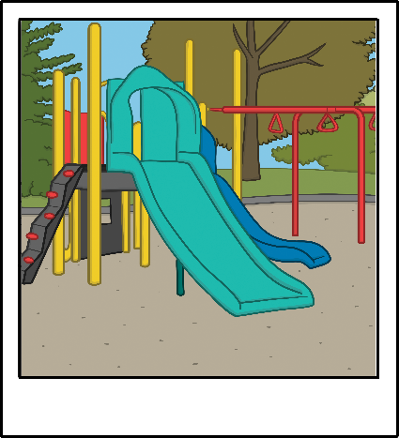
Planet Earth
Our planet is amazing and beautiful.
Think about your favourite outside place.
What do you like about this place? What makes it special?
Is it the countryside?
Is it the seaside?
Is it the park?

Slide 11
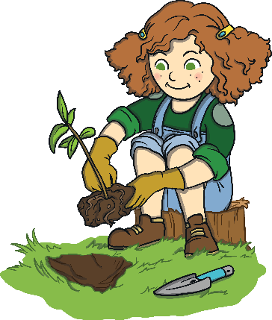
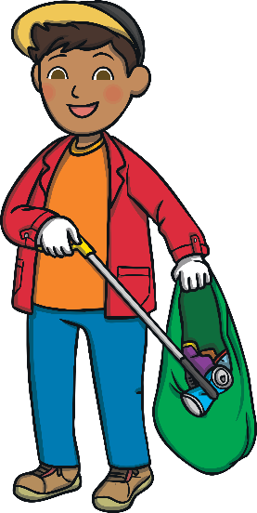
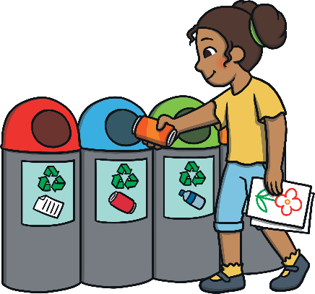
Looking After Our Planet
Earth Day helps us learn about ways to look after our planet.
We can do these things all year round, not just on Earth Day.
Have you done any of these things?
planting trees
and flowers
picking up litter
recycling

Slide 12




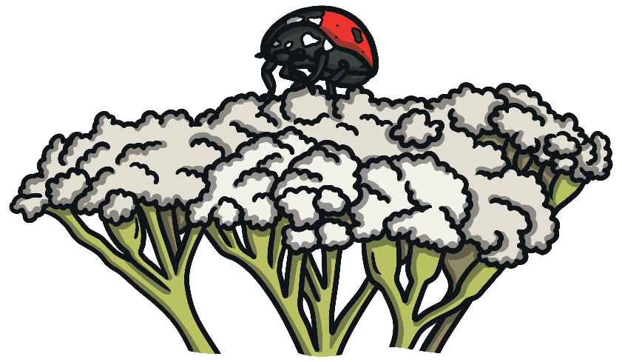
Planting Trees and Flowers
Trees, plants and flowers provide food and homes for animals. They also help to create clean air for us to breathe.
You could ask a grown-up to help you plant some trees or flowers.
You might see some wildlife, such as minibeasts, around the trees and flowers you plant.
Year 1 will be doing this as part of their Earth day activities

Slide 13
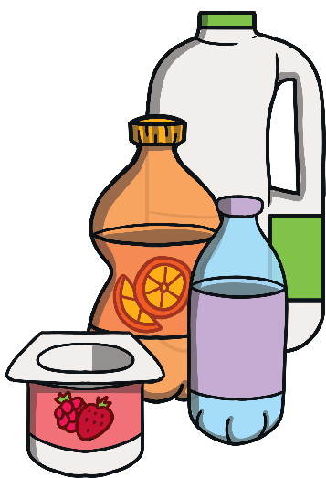
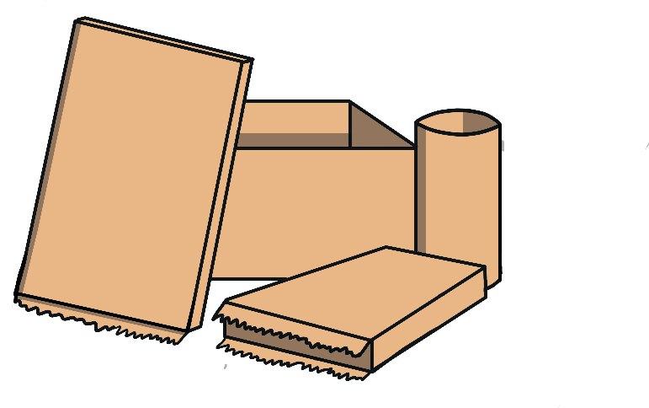
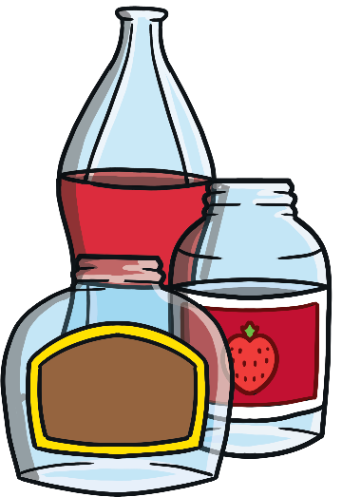

Recycling
Some materials can be recycled. This means that once we’re finished with them, they can be turned into new things for us to use.
Plastic, paper and glass are some
materials that can be recycled.
Eco Team have been making posters to remind you about recycling in the classrooms.
These posters will go up very soon.

Slide 14

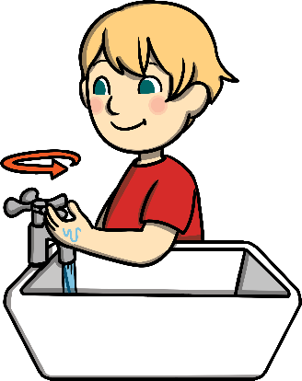

Looking After Our Planet
This year, Earth Day hopes to encourage people to use clean energy sources, like the sun and wind, to help keep our Earth healthy.
Here are some more ways we can help the environment by not wasting precious resources
turn off lights
Use an eco-friendly
product and less plastic
use less water

Slide 15
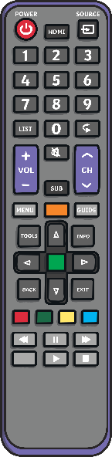



Turn Off Lights
Switching off lights when they are not needed helps to save energy.
When you leave a room, remind a grown-up to switch off the light.
Other things can also be
switched off when they are
not being used to help
us save energy, such as
TVs and computers.

Slide 16
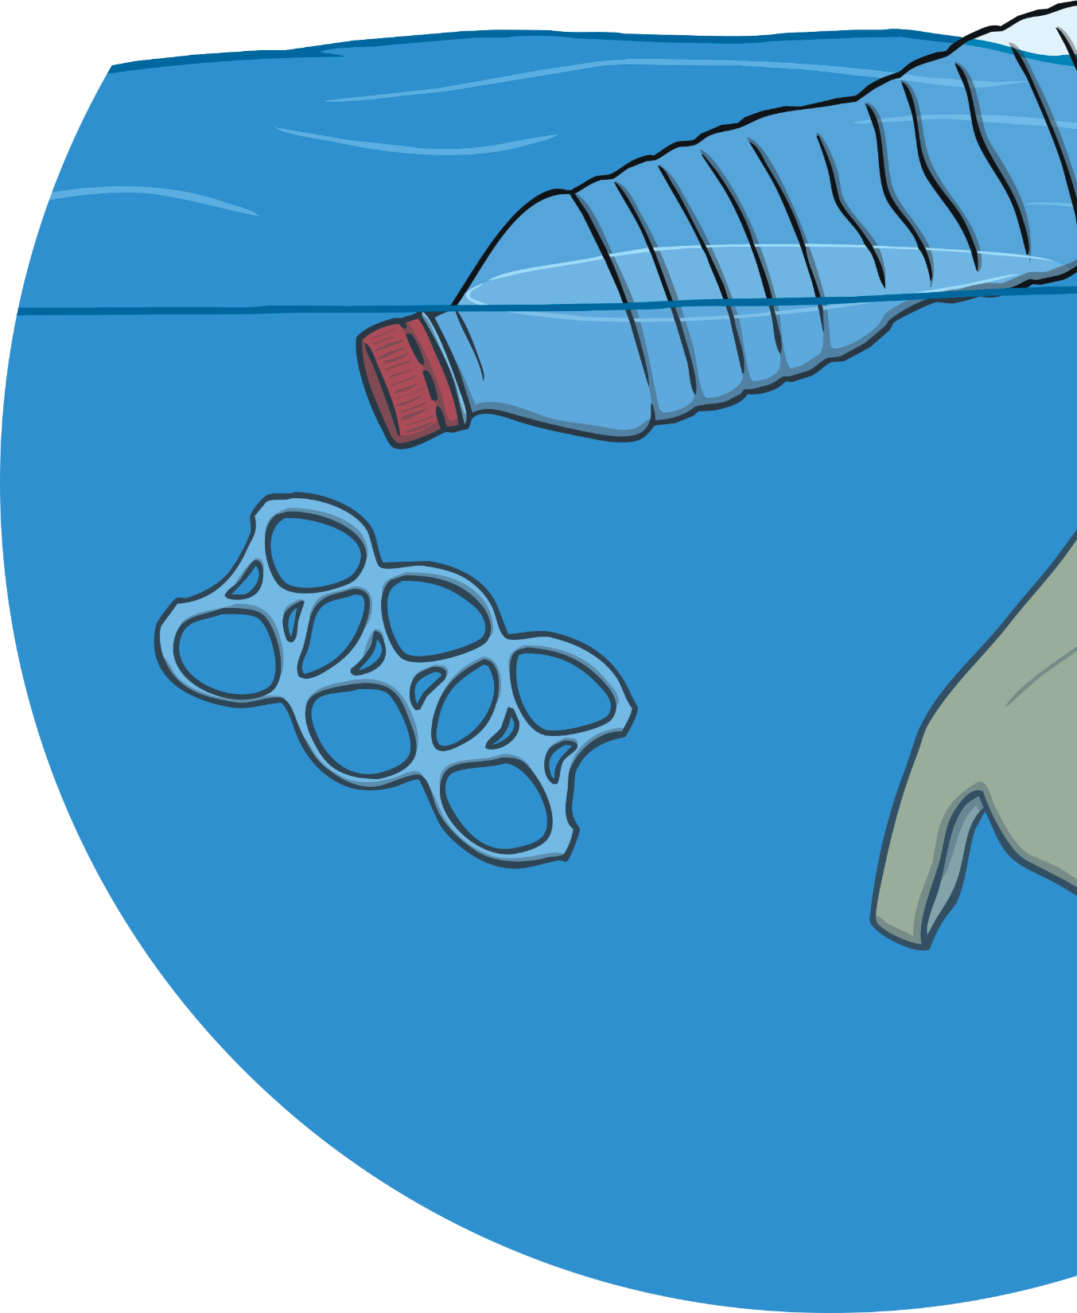
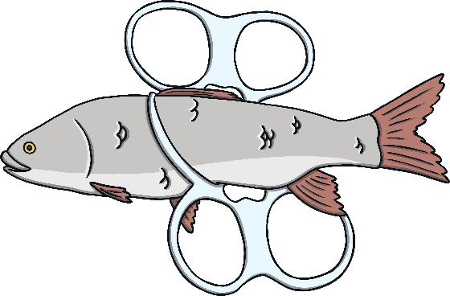


Eco-Friendly Products
Lots of things we use are often made of plastic.
Plastic is made in factories using materials that come from oil and gas, which are not clean energy sources like the sun or wind.
Plastic can be harmful to the environment. It takes a long time to break down and can harm plants and animals.
Instead, you can try to use eco-friendly products that are made from other materials, such as fabric or paper.
For example, instead of plastic carrier bags, you could use a fabric bag when you go to the shops.

Slide 17

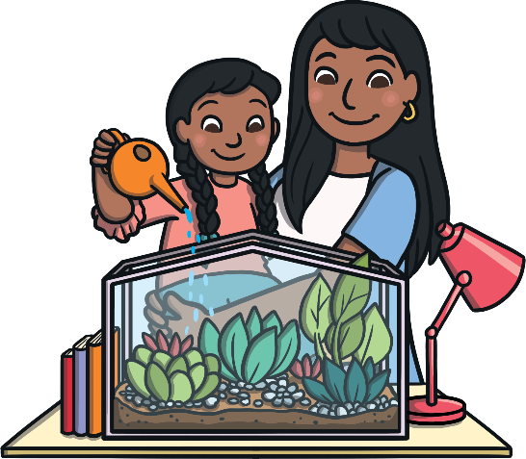
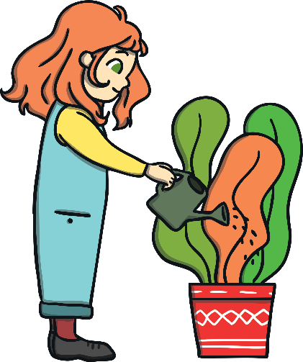
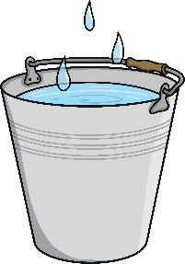

Use Less Water
Saving water also helps reduce the energy we use. If we use less water, we save energy.
We can help to save water in many ways, such as turning taps off after washing our hands or when we are brushing our teeth.
Outside, rainwater can be collected in large buckets or containers.
This water can be used to water plants and wash cars or windows.

Slide 18

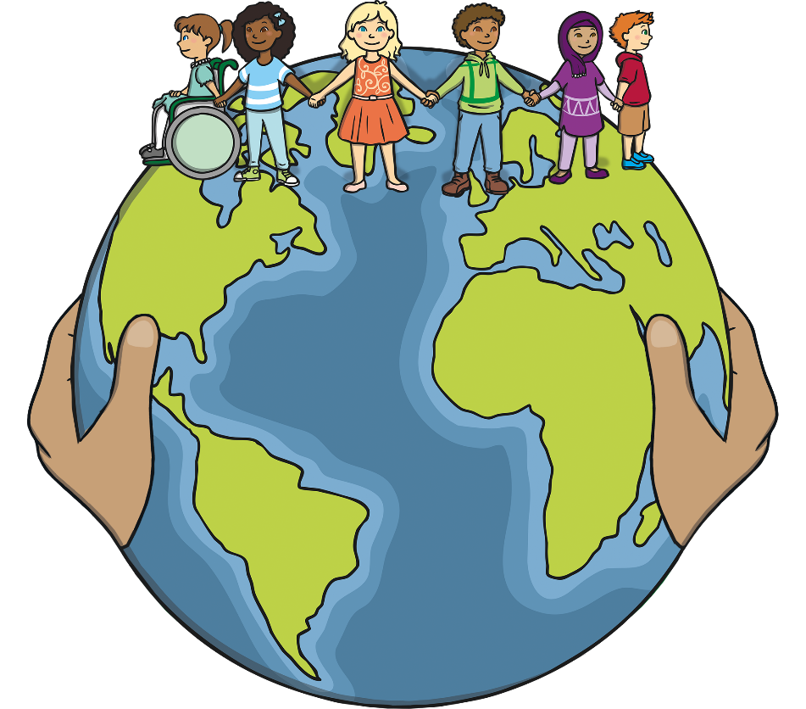

Now lets work together to participate in Earth day and make a change.
April
All the activities you will do this morning will have a positive impact on our world and help the environment

